Slide 1
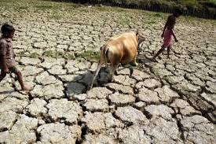
All are students welcome

Slide 2
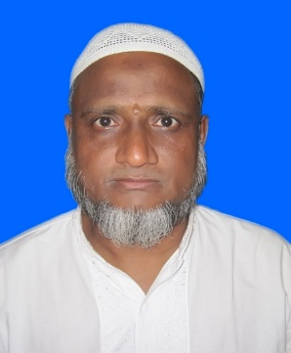
Introduc in
Saidul hoque
Assist: Teacher
Enayetpur Rahmatia Alim Madrasha
Senbag, Noakhali.
Subject: English for today
Class: Dakhil class seven
Unite: Nine
Lesson: One
Duration: 50 minute

Slide 3
Todays Lesson
Mother Earth in crisis

Slide 4
Learning Outcome
After we have studied this Lesson, we be able to
Read and understand texts
Talk about climate and environment
Ask and answer questions

Slide 5
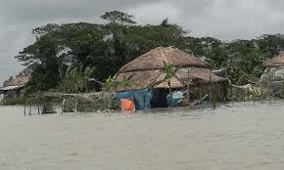
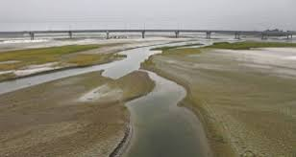
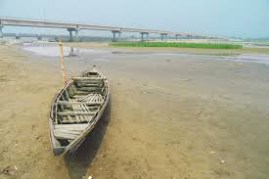
What are see in thes
Picture?

Slide 6
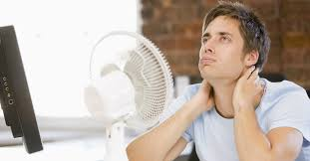
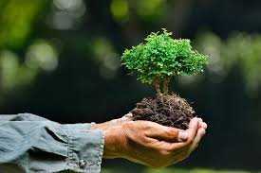
Word and pronounciation | Picture of Synonyms | Meanings in bangla
Uncomportable |  | অস্বস্তিকর
Environment |  | পরিবেশ

Slide 7
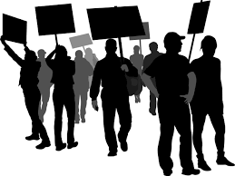
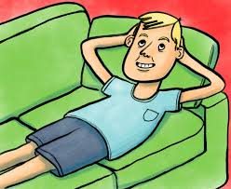
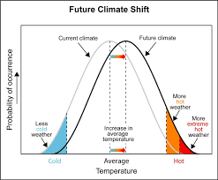
Activist |  | সহযোগী
Idle |  | অলস
Climet shift |  | জলবায়ু পরিবর্তন

Slide 8
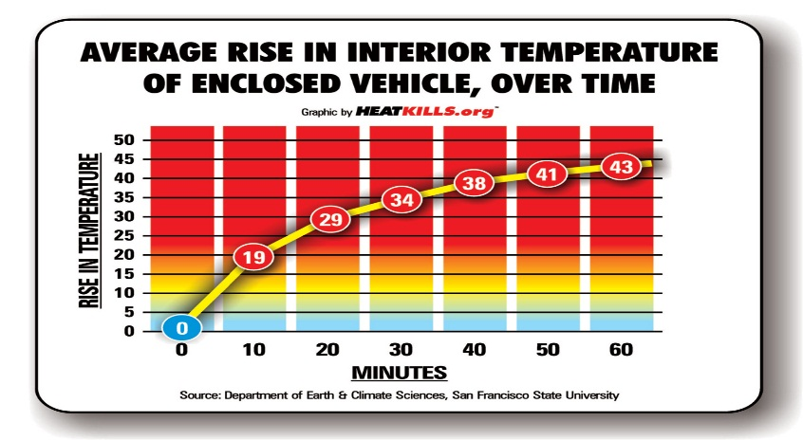
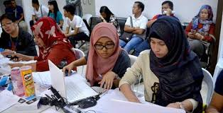
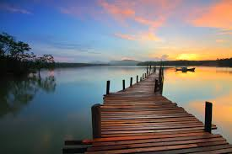
Temperature climb |  | তাপমাত্রা উপড়ে উঠা
Crisis service |  | বিপদে টিকে থাকা
Landscape |  | দৃশ্য

Slide 9
Read the text and the conversation: Samina is in class 7 and Arif in class 6. They both felt very uncomportable the other day. It was just the beginning of March . And the day was very hot. In the small town of Sherpur, summer had come with all its heat and warmth. Samina and Arif had nothing much to do. While sitting idle on the veranda, they saw their uncle Anower coming to them. Anower work in an NGO called Save the Earth. Samina and Arif started taking with uncle about weather and climate.

Slide 10
Individual Work
Choose the right answer:
Which of these is an example of climate change?
(a) A long day (b) A wind day (c) a hot summer day (d) a sunny day
2.What does ‘climbing’ mean in the statement “temperature are l climbing”?
Shifting (b) going up (c) being in crisis (d) surviving
3. If things go on like this ……In this sentence ‘go on’ means
To go place (b) to change time (c) to walk fast (d) to continue
Anwser: 1. a long day 2. going up 3. to continue

Slide 11
Evaluation:
Give short answer to the following questions-
What class does Samina read in?
How did both Arif and Samina feel the other day?
Where had summer come with all its heats and warmth?
Why were Samina and Arif sitting idle?
What is the name of their uncle?
What is Anower?
What did they start talking about?

Slide 12
Look at the answer seet:
Samira read in class 7.
Both Arif and Samina felt uncomportable the other day.
Summer had come with all its heat and warmth in the small town of sherpur.
Samina and Arif were sitting idle because they had nothing much to do.
The name of their uncle is Anower.
Anower is an NGO worker.
They started talking about weather and climate.

Slide 13

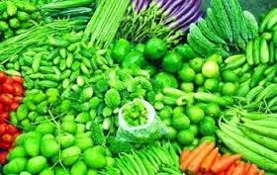
Thanks all are students

